Slide 1
Exploring NYPD Shootings Incidents: A Data Analysis using R Notebook
Notes:
This presentation covers the analysis of NYPD Shootings Incidents from 2006 to 2021 using R Notebook. It includes data retrieval and cleaning, borough and year-wise shootings analysis, and statistical analysis. The presentation also includes visualizations in the form of bar charts, line charts, and insights gathered from the data.

Slide 2
Introduction
Objective: Analyzing NYPD Shootings Incidents from 2006 to 2021 using R Notebook.
Tools: R Notebook, knitr, tidyverse, lubridate, ggplot2.

Slide 3
Data Retrieval and Cleaning
Data Source: NYPD Shootings Incidents dataset from NYC Open Data.
Libraries Used: tidyverse, lubridate.
Data Cleaning Steps:
Selected relevant columns.
Converted date and time columns to appropriate formats.
Created a new variable for shootings.
Extracted the year from the date.

Slide 4
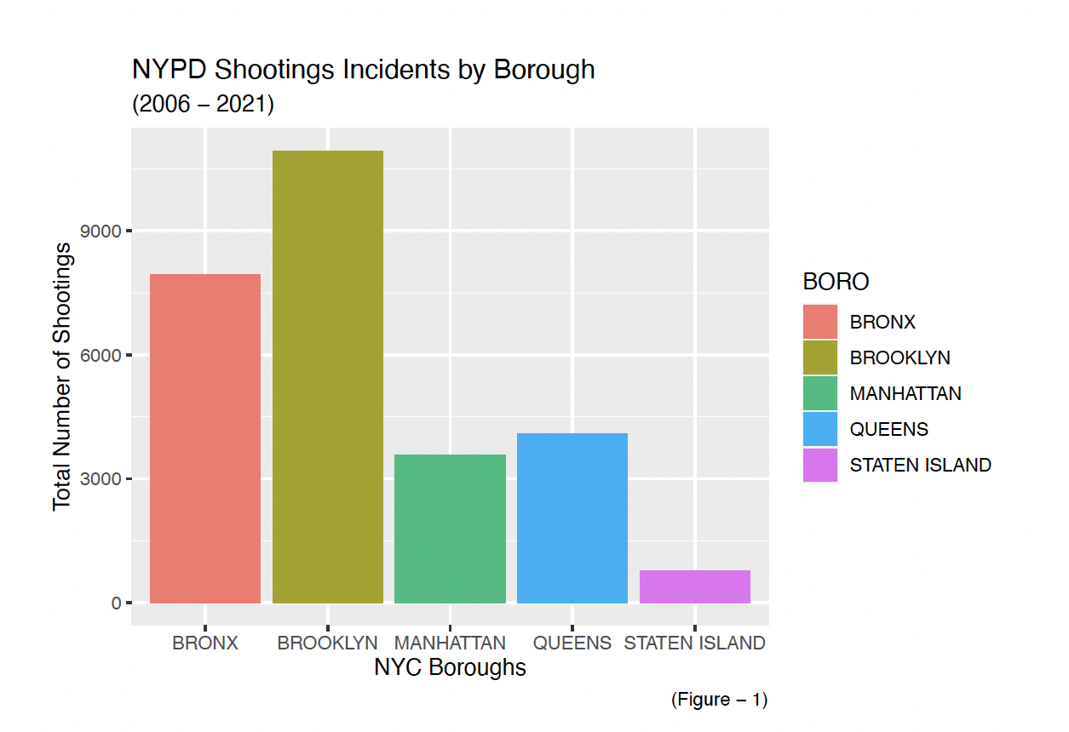
Shootings by Borough
Notes:
total shootings by borough.
Brooklyn has the highest number of shootings.
Staten Island has the lowest number.

Slide 5
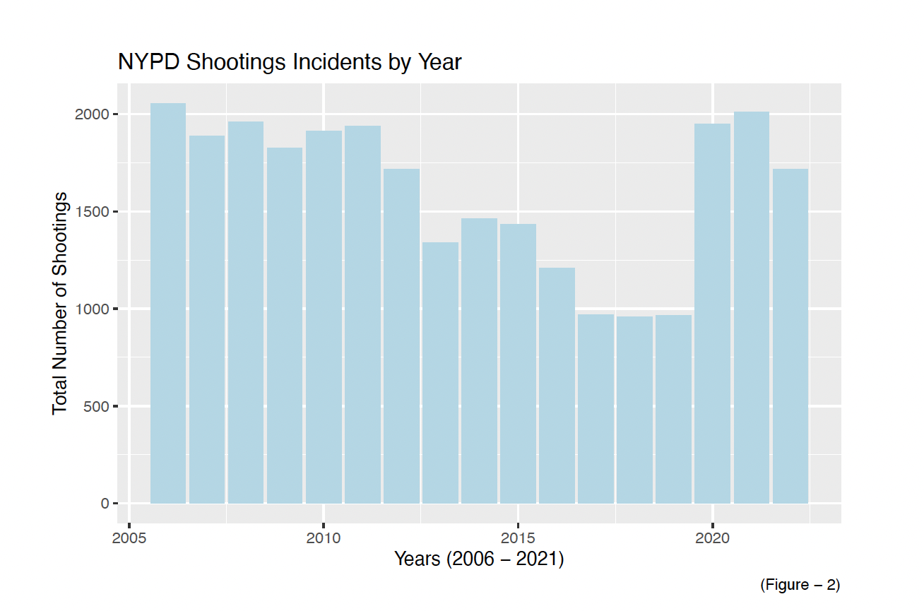
Shootings by Year
Notes:
A gradual decline in last year.
Shootings peaked around 2006.

Slide 6
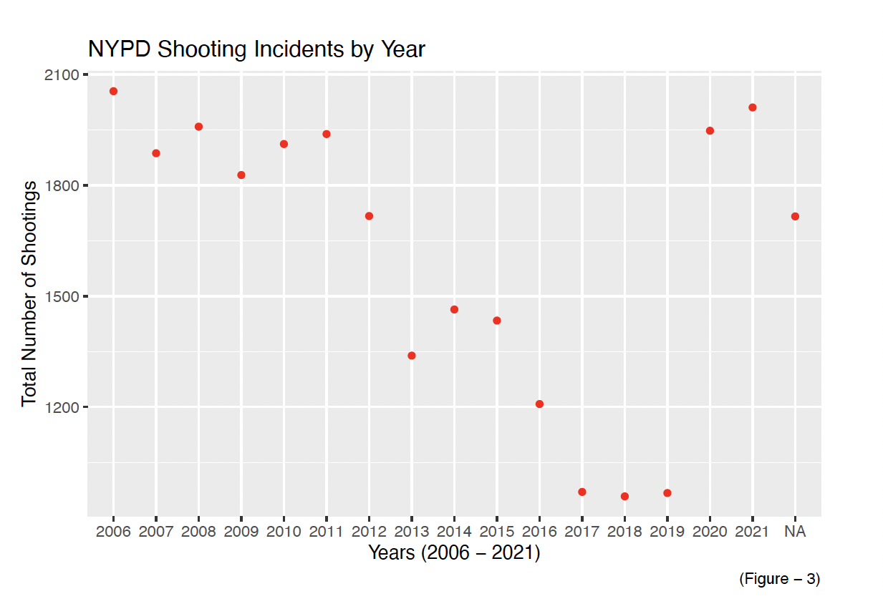
Shootings Trends Over Years
Notes:
shootings trend over 2006-2021
Anomaly in 2020 and 2021 - Pandemic
Overall decreasing trend in shootings.

Slide 7
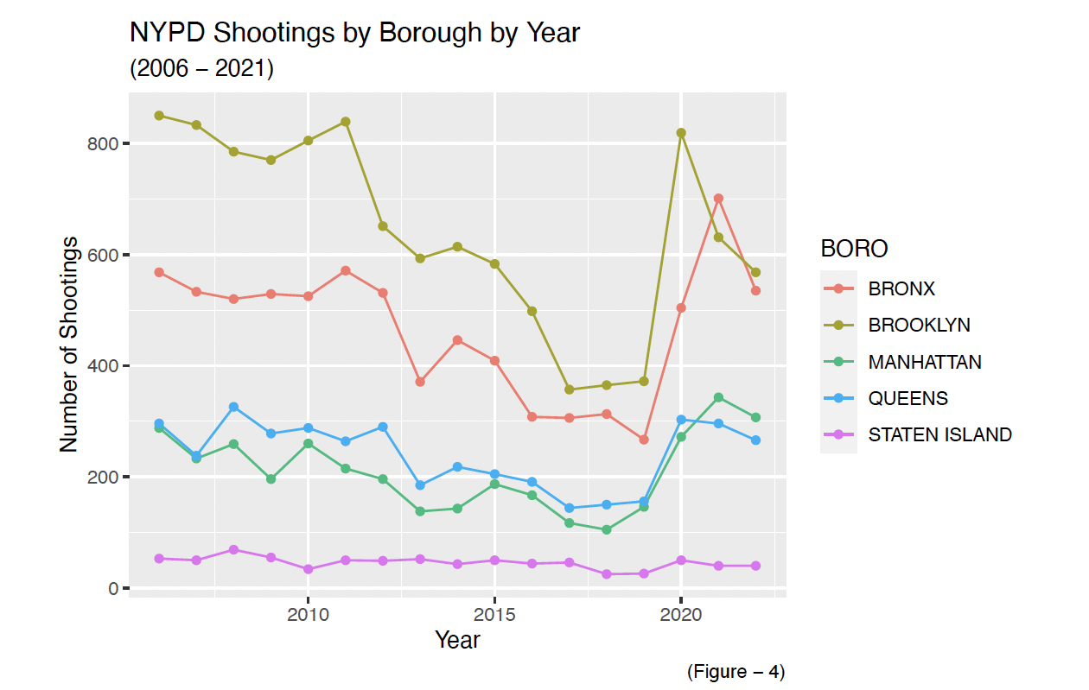
Borough-wise Shootings Over Time
Notes:
Other boroughs show varying trends
Line chart depicting borough-wise shootings by year.
Brooklyn consistently has the highest shootings.

Slide 8
Statistical Analysis
Notes:
65% of total shootings occurred in Brooklyn and Queens.
Only 2.7% of total shootings occurred in Staten Island.

Slide 9
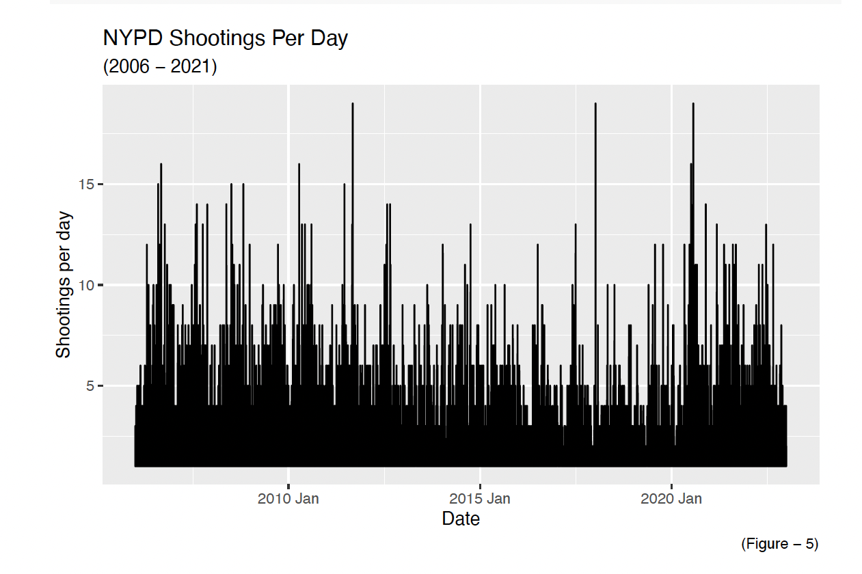
NYPD Shootings Per Day
Notes:
daily count of shootings from 2006 to 2021.
Highest shooting days around July 4th, 2023.

Slide 10
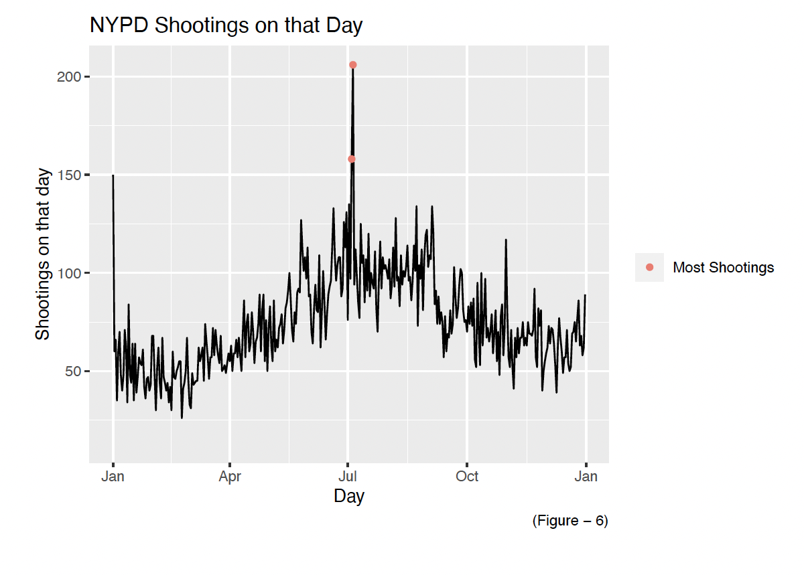
Shootings on July 5, 2023
Notes:
The second-highest shootings occurred on July 4, 2023.
July 5, 2023 had the highest number of shootings.

Slide 11
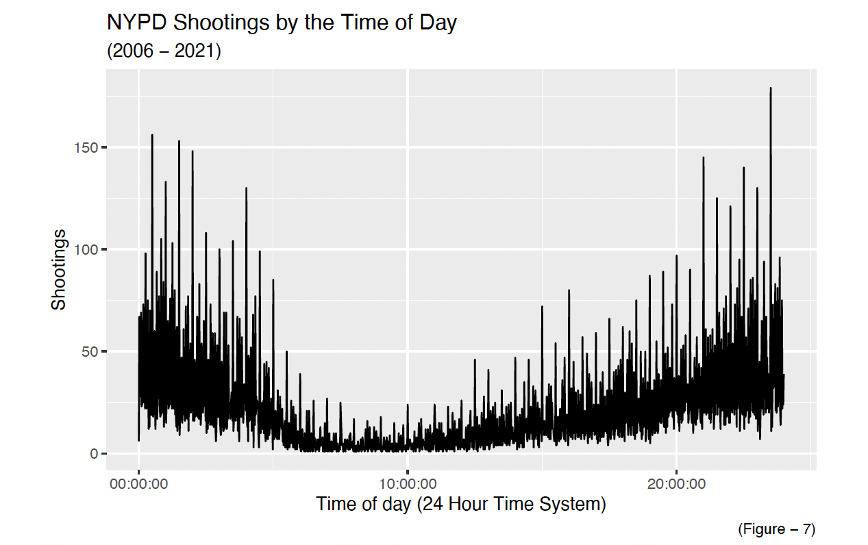
Shootings by Time of Day
Notes:
Shootings less likely to occur between 5am and 3pm
Shootings most likely to occur between 8pm and 2am

Slide 12
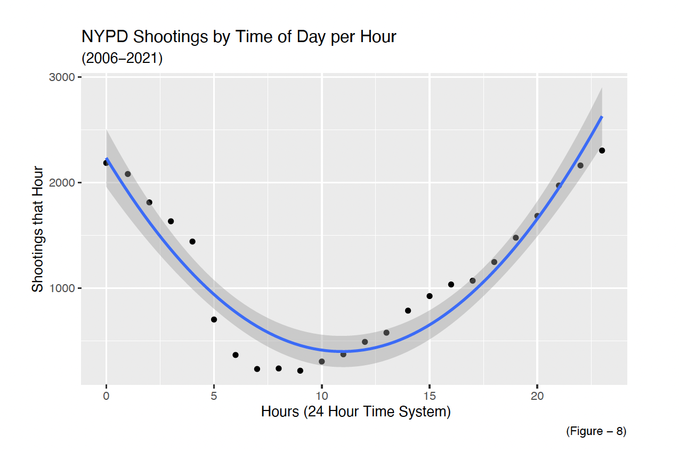
Shootings by Time of Day per Hour
Notes:
Shootings less likely to occur between 5am and 3pm
Shootings most likely to occur between 8pm and 2am

Slide 13
Conclusion

